Slide 1
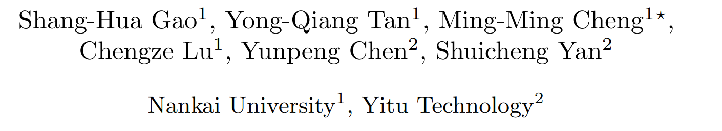
﻿﻿﻿ ﻿Highly Efficient Salient Object Detection with 100K Parameters

Slide 2
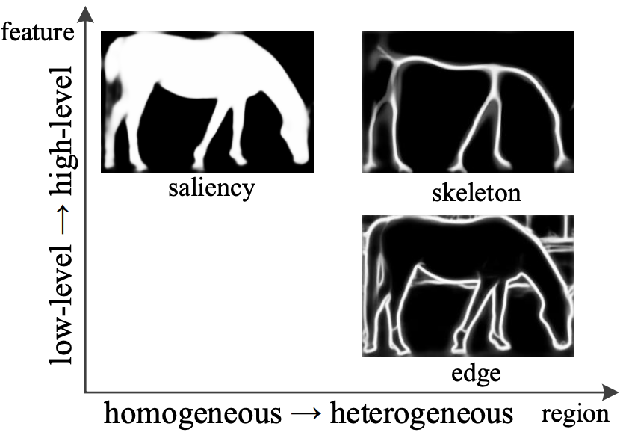




Salient detection
Origin image
Salient map

Slide 3
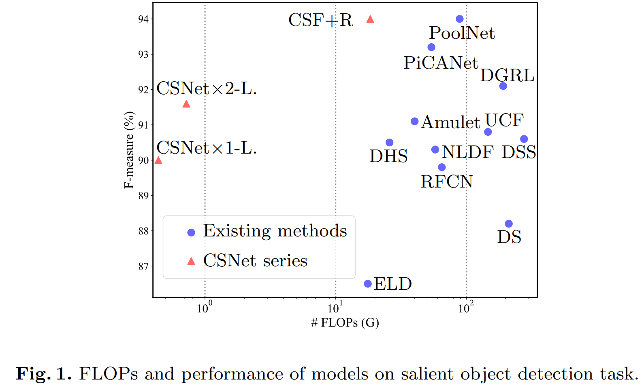
﻿Main Contribution
﻿100K Parameters Efficient Model
General Octave Conv + Pruning Strategy

Slide 4
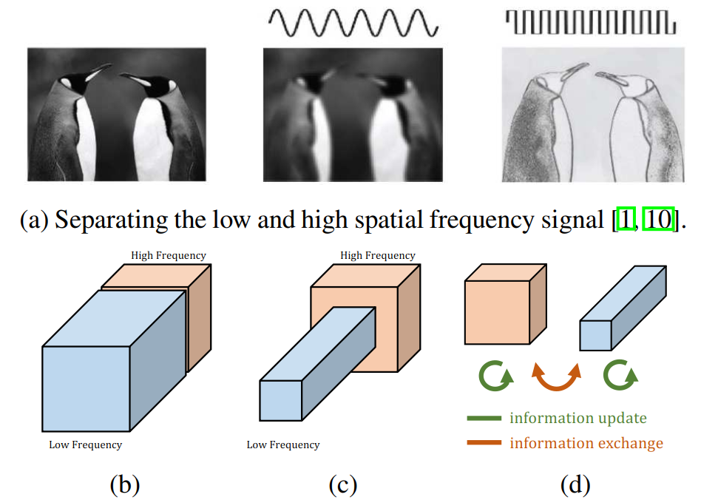
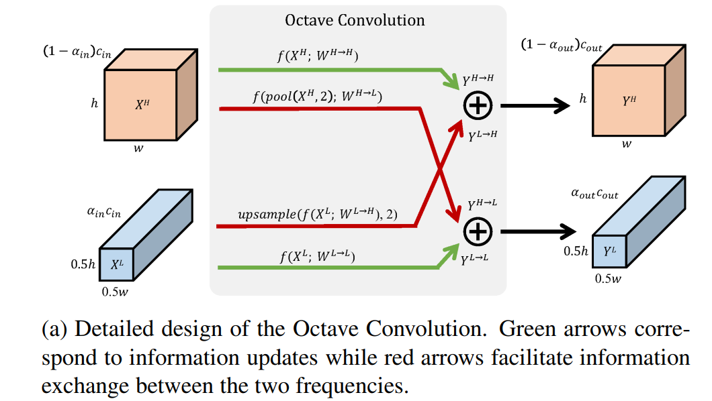
Method
Octave Convolution
﻿Drop an Octave: Reducing Spatial Redundancy in Convolutional Neural Networks with Octave Convolution

Slide 5
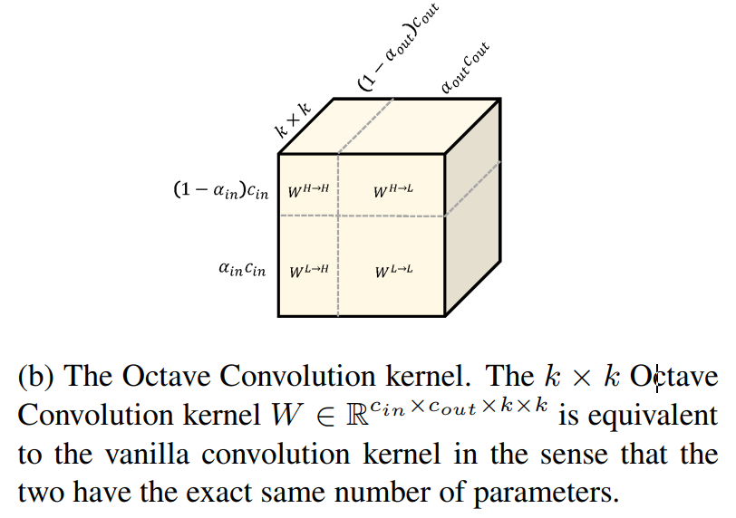
Method
Octave Convolution
﻿Drop an Octave: Reducing Spatial Redundancy in Convolutional Neural Networks with Octave Convolution

Slide 6
Method
Octave Convolution
﻿Drop an Octave: Reducing Spatial Redundancy in Convolutional Neural Networks with Octave Convolution
Problem:
Only two-scales within a stage can not introduce enough
multi-scale information

Slide 7
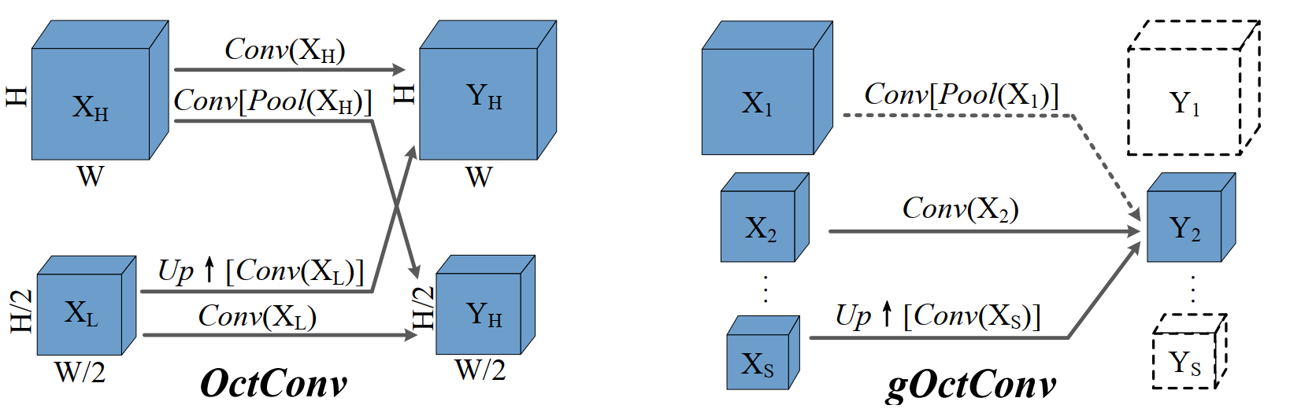
Method
General Octave Convolution (gOctConv)
1.﻿Arbitrary numbers of input and output scales is available
2. the gOctConv can also process cross-stages features with arbitrary scales from the feature Extractor
3. ﻿Cross-scales feature interaction can be turned off to support a large complexity flexibility

Slide 8
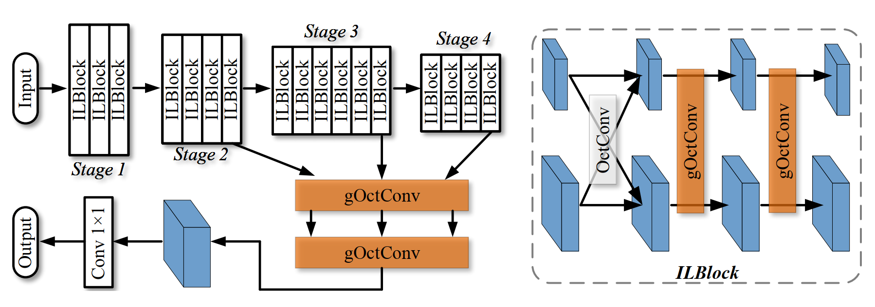
Method
Network architecture
﻿In-layer Multi-scale Block: multi-scale
﻿Cross-stages Fusion: multi-stage

Slide 9
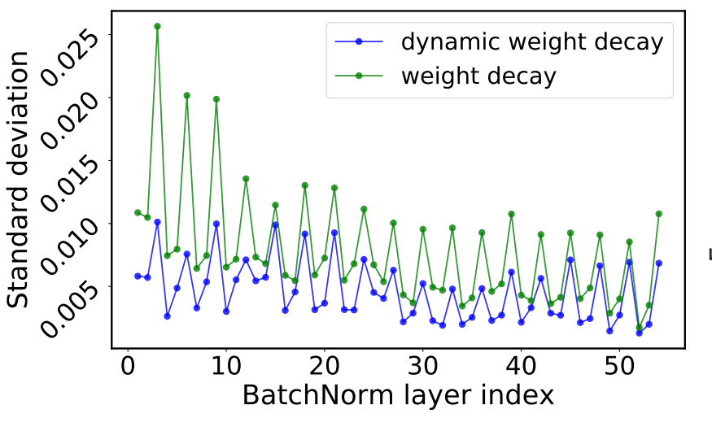
Method
﻿Learnable Channels for gOctConv
﻿Ruan reveals that channels with diverse outputs are more likely to contain noise, leading to biased representation for subsequent filters.

Slide 10
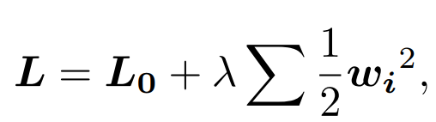
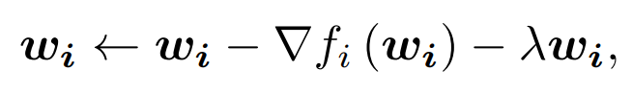
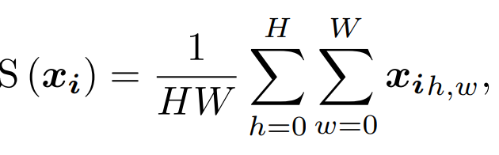
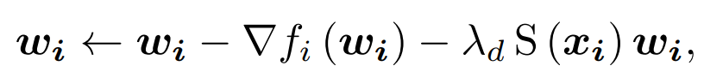
Method
﻿Learnable Channels for gOctConv
Normal Weight Decay
Using a ﻿Dynamic Weight Decay
﻿The weights producing large value features are suppressed, giving a compact and stable weights and outputs distribution

Slide 11
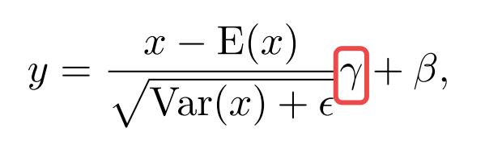
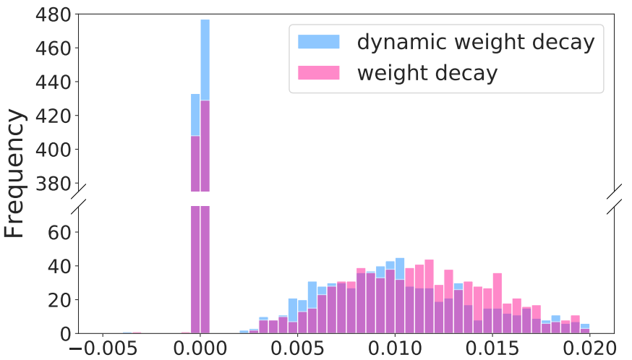
Method
﻿Learnable Channels for gOctConv
﻿Using the weight of BatchNorm layer as the indicator of the channel importance
﻿There is a clear gap between important and redundant weights
﻿Unimportant weights are suppressed to nearly zero (wi < 1e−20)

Slide 12
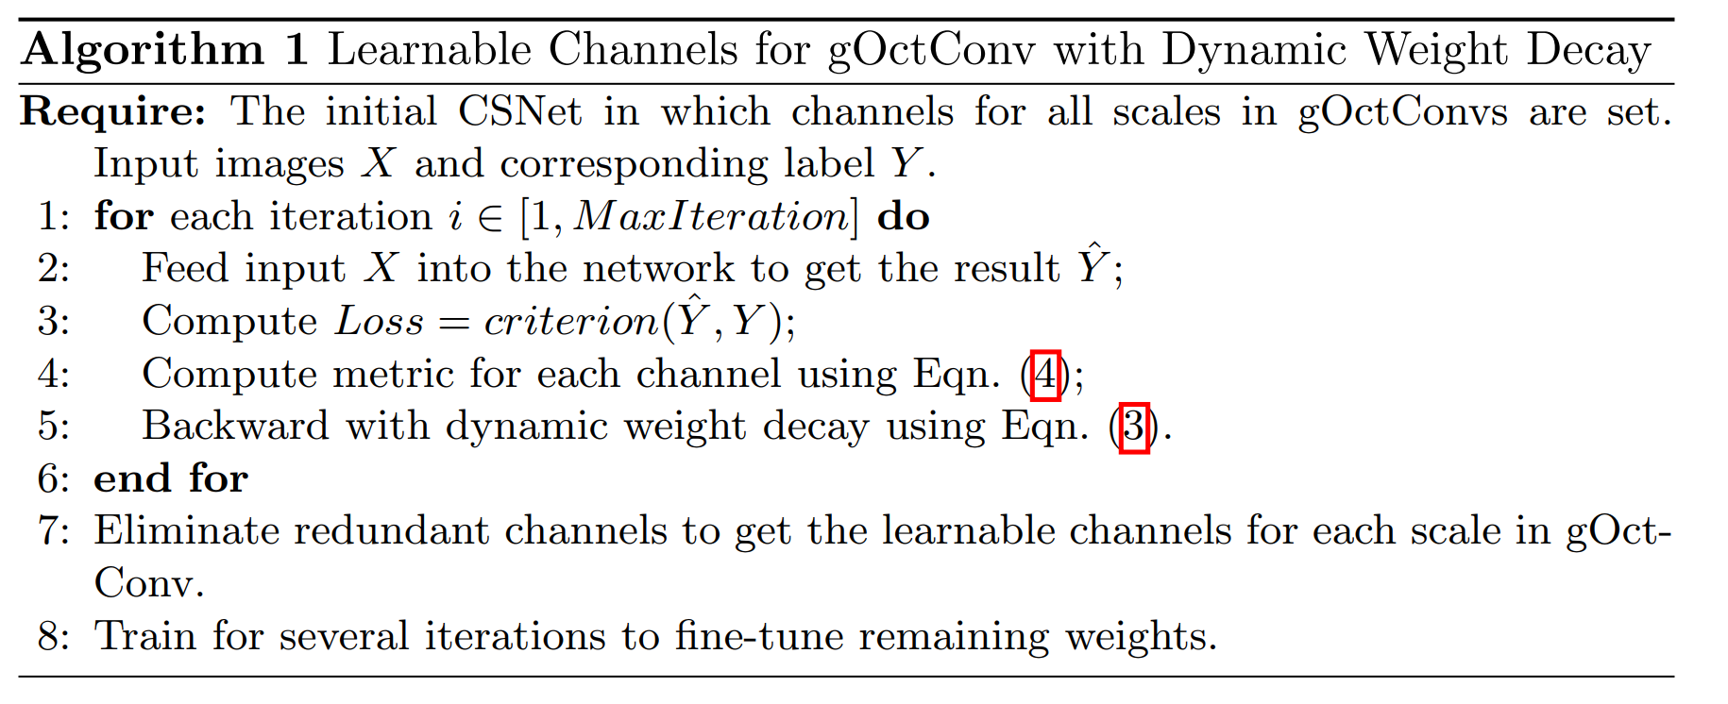
Method
﻿Learnable Channels for gOctConv

Slide 13
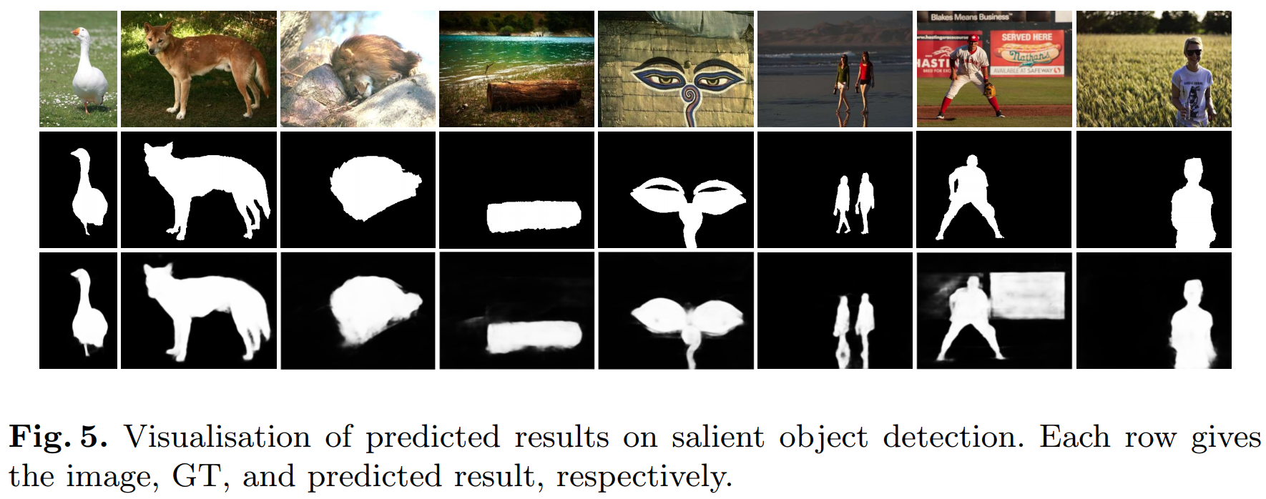
Result

Slide 14
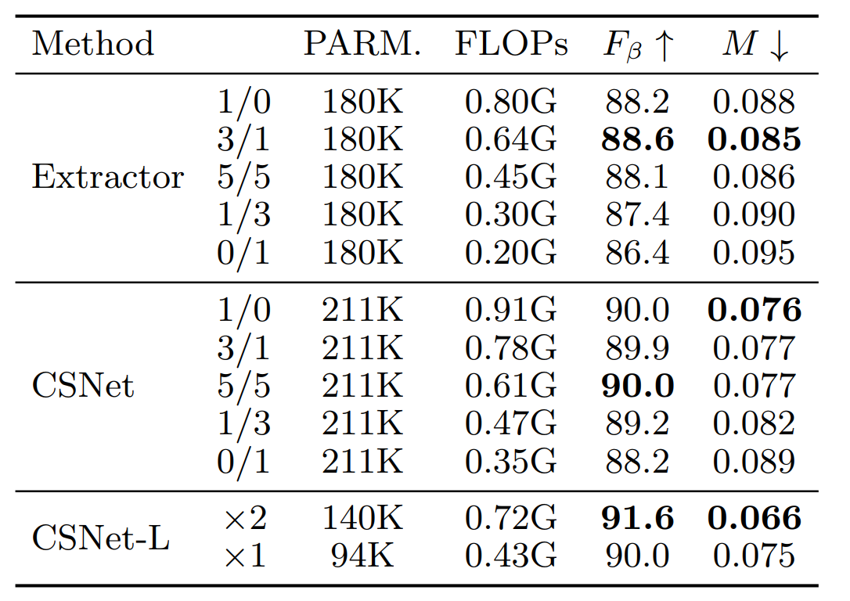
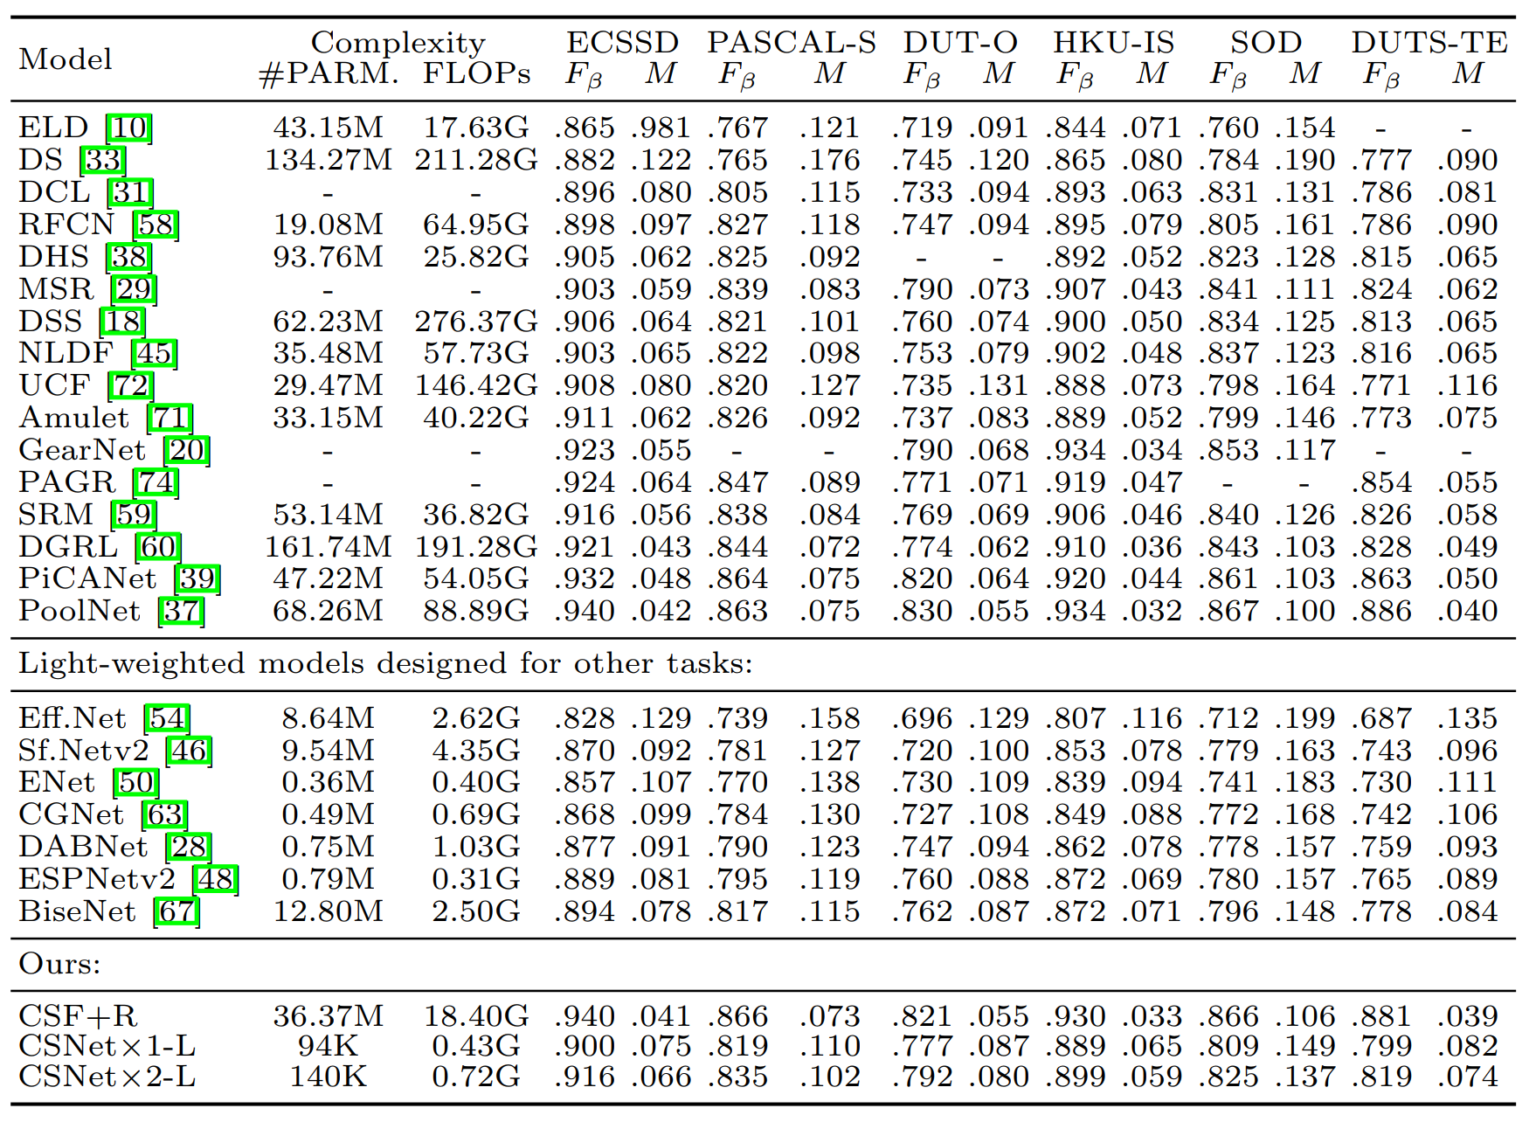
Result

Slide 15
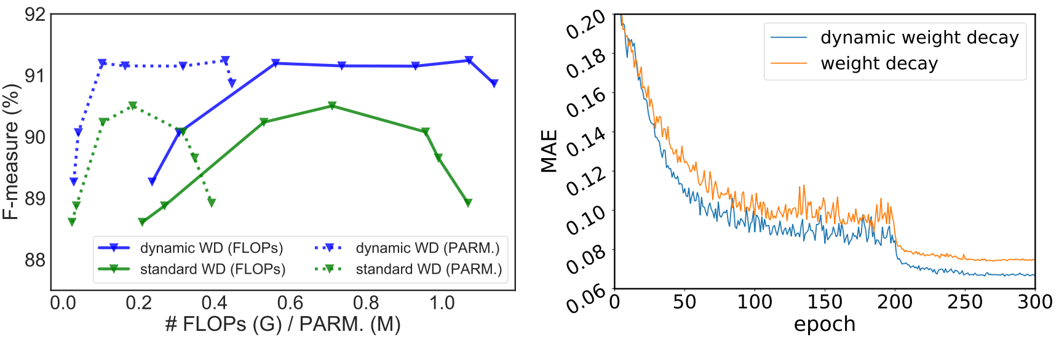
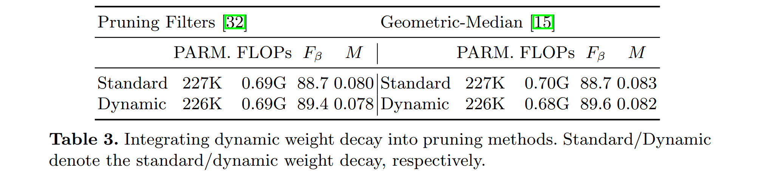
Ablation study

